Slide 2

WE WILL COVER
  Key Parties Involved
  Management of the Fund
  Fund Characteristics
    Investor Profile
    Investments
    Exposures – Capital Security
    Liquidity
    Yields
  Investment Class and Fees
  Universe
  Close

Slide 3




KEY PARTIES
Southchester Investment Managers Portfolio Manager
Absa Alternative Asset Management Sub-investment Advisor
Management Company
IP Management Company (RF) (Pty) Limited
Platform
Investment Management Services

Slide 4

SOUTHCHESTER INVESTMENT MANAGERS
    Southchester is an independent specialist fixed income asset manager
    Over R9.8 billion in assets under management
    Highly experienced investment team
    Innovative fixed income offerings

Slide 5
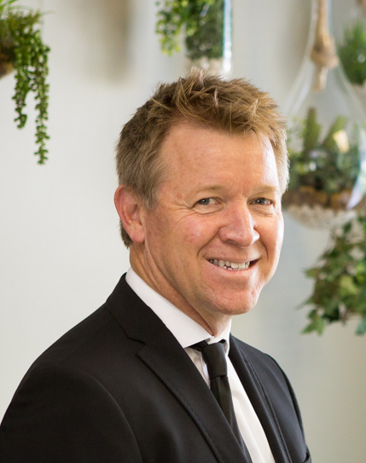
SOUTHCHESTER INVESTMENT MANAGERS
Mike is a specialist in financial products with a strength in product structuring and portfolio management for over 20 years.
Over his professional career, Mike has developed and implemented numerous innovative solutions for corporates and institutions covering structured and corporate financing and equity derivative structuring.
Mike’s portfolio management experience of eight years ranges from a Sharia compliant fund that he established and managed at Investec, through to a protected investment portfolio he was responsible for managing at Cadiz Asset Management.
Mike holds a BCom economics degree, with postgraduate qualifications in both accounting and taxation and a MBA.
MIKE BALDWIN

Slide 6
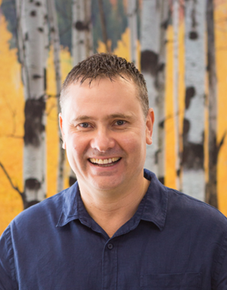
SOUTHCHESTER INVESTMENT MANAGERS
Gregg has 20 years' financial structuring and investments experience. While doing his SAICA articles, he developed a wealth of experience in international tax and foreign exchange issues. Over time, he became more involved in the banking, financial and investment aspects of local and international taxation and eventually joined the asset management industry specialising in fixed income.
He now focusses on providing structured solutions to institutional and corporate clients and developing innovative investment products. One such product was the Absa Dividend Income Fund, a fixed income fund which at its zenith exceeded ZAR13.5 billion AUM and which he managed for the Absa Group. He now jointly manages the Southchester (RF) Limited fixed income portfolio, the Southchester Smart Escalator Prescient QIH Fund, various segregated mandates and the Southchester IP Optimum Income Fund.
GREGG BAYLY
He obtained a B. Comm Honours degree and later became an associate member of the British Chartered Institute of Management Accountants after which he obtained an LLB degree.

Slide 7
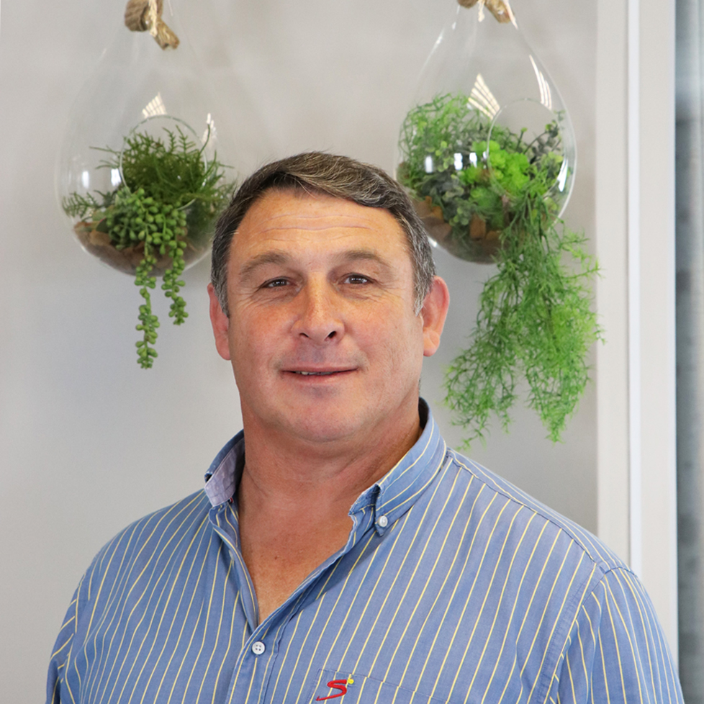
SOUTHCHESTER INVESTMENT MANAGERS
Bertus commenced his career in life and group insurance at Old Mutual.
Found his passion in Investments and Investment Marketing while at Metropolitan Investments, Ovation Global Investments, where he served as Director and Gryphon Asset Management.
At Gryphon he served in a Business Development & Sales Management capacity and was also responsible for growing and building the brand presence in the market. He was instrumental in the marketing of the Absa Dividend Income Fund, a fixed income fund which at its zenith exceeded ZAR13.5 billion in assets under management and where Gryphon was the Fund Manager.
BERTUS ENSLIN

Slide 8

ABSA ALTERNATIVE ASSET MANAGEMENT
  100% owned by Absa Group Limited
  Authorised Financial Services Provider in South Africa (FSP 2A no. 22877)
  Discretionary fund manager
    AUM of ZAR 70 billion (USD 5 billion)
    Mostly institutional wholesale clients
  Why AAM?
    OTC derivatives products, hedges and alpha transport
    Fixed income portfolios have strong focus on credit
    Higher yielding and non-traditional debt
    Proven credit management track record
    Specialist skills in credit assessment
  Backed up by global standards in operational infrastructure & governance
  AAM is appointed as sub-investment advisor to the Fund specifically tasked with credit risk management and monitoring

Slide 9
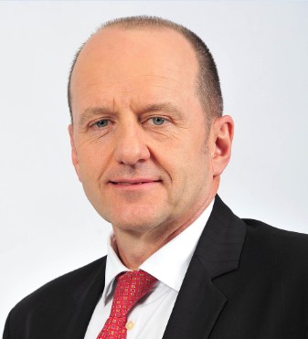
ABSA ALTERNATIVE ASSET MANAGEMENT
Mcom (Investment Management),FCIS
Head of Credit at AAM
Senior Portfolio Manager at AAM
26 years industry experience
Together with the AAM team, Pieter is responsible for the credit risk management and monitoring duties for the Fund
Pieter is a member of the Fund’s Investment Credit Committee together with the Portfolio Managers at Southchester
Prior to joining AAM in 2016, he was responsible for credit portfolio management at Absa Corporate and Investment Bank
PIETER VAN DER MERWE

Slide 10
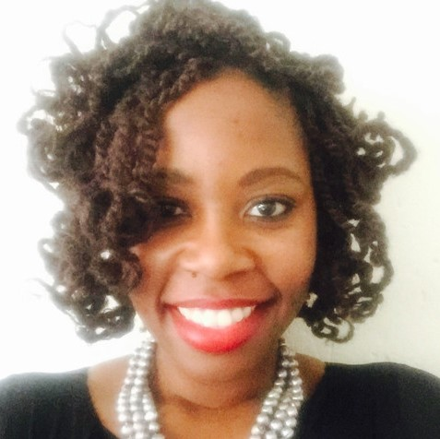
SCOI FUND – AAM KEY PEOPLE (Proposal for Marketing Pres)
B Comm, LLB, Post Grad Diploma International Economic Law
Head of Legal and Deal Architect at AAM
7 years industry experience and highly skilled and trained lawyer having worked at one of the major SA law firms
Together with the AAM team, Tshidi works closely with Pieter and focusses on the legal aspects related to the credit analysis of the investments held by the Fund
Tshidi is a alternative member of the Fund’s Investment Credit Committee together with the Portfolio Managers at Southchester
Prior to joining Absa WIMI and then later AAM specifically, Tshidi articled and worked at Werksmans Attorneys
Motshidisi Mazibuko (‘TSHIDI’)

Slide 11
Fund structure
SOUTHCHESTER
ABSA ALTERNATIVE ASSET MANAGEMENT
Sub-Investment Advisor to the Portfolio Manager
Portfolio Manager
INVESTMENT & CREDIT COMMITTEE
ABSA CREDIT
ABSA REGULATORY – LEGAL & TAX
FUND
ABSA COMPLIANCE
MAITLAND
IP MANAGEMENT COMPANY
JTC GROUP
STANDARD BANK INVESTOR SERVICES
Asset Administrator
Manager
Liability Administrator
Trustee

Slide 12

FUND CHARACTERISTICS
  CISCA regulated Collective Investment Schemes Portfolio
  Capital secure dividend yielding investment offering
  Stringent risk profile aimed at preserving capital
  Only floating rate investments will be included in order to limit potential losses being incurred due to interest rate hikes
  The Fund strives to maintain a constant R1.00 price per unit
  Income will be paid monthly in arrears or reinvested as elected in accordance with industry practice

Slide 13
INVESTOR PROFILE
  Capital secure dividend yielding investment offering
  Individual investors, trusts & corporates
    Secure investment
    Yield vs risk
    Tax efficient income

Slide 14
KEY QUESTIONS INVESTORS ASK
  What am I exposed to ?
  How accessible is my investment / capital ?
  What is the return / yield ?

Slide 15
INVESTMENTS
  Redeemable preference shares
    The issuers of such shares have the obligation to redeem / repay the issue price paid for the shares at a future date.
    Where the issuer is a leading bank there is no need for additional support given the creditworthiness of the issuer.
    If the issuer is another institution, we secure additional support in the form of a guarantee or put option from a creditworthy counterparty.
  Protected Equities
    The equities are protected by means of put options issued by leading financial institutions / banks;
    The put option gives the Fund the right to sell these investments at the price they were purchased for thereby providing capital protection;

Slide 16
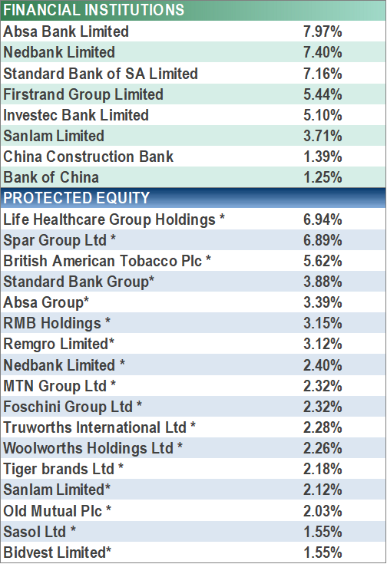
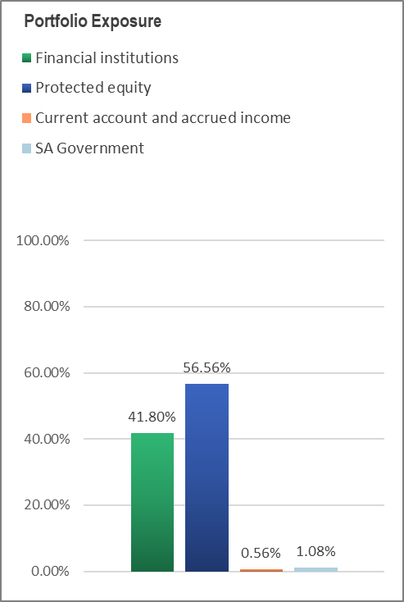
PORTFOLIO EXPOSURE
  * As of end January 2019

Slide 17
PROTECTED EQUITY
    As previously stated, the equity shares are protected by means of put options obtained from leading institutions or banks
    Particular attention is paid to the financial standing of all put option providers
    A put option is only as good as the person providing the put option
    We further obtain additional security to back the put options and the value of the security must exceed the purchase price of the protected equities by at least 15%
    The security provided is a combination of debt instruments and equity shares which are pledged to the holder of the put option (i.e. the Fund)
    The following slide gives a list of the security pledged to the Fund

Slide 18
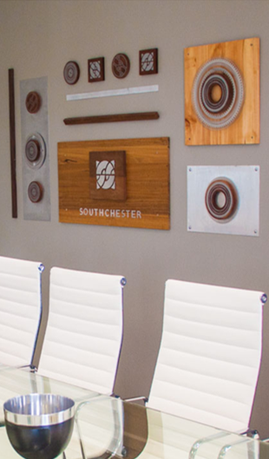
LIQUIDITY
  Standard CISCA regulations
  Ability to create liquidity similar to that of other regular income funds
  Percentage of portfolio held in liquid /cash investments
  Access to liquidity facilities

Slide 19

REPURCHASE TIME TABLE
Repurchase
Business cut-off to receive an instruction | Process the instruction | The administrator sells units (Manco) | Unit price received from the manager | Reflect in investor Bank Account(Absa Bank)
Before 13:00 (Day 0) | Day 0 | Day 1 | Day 2 | Day 3
After 13:00 (Day 0) | Day 1 | Day 2 | Day 3 | Day 4

Slide 20
SCOI FUND – YIELD BENEFIT CALCULATION FOR INDIVIDUALS
  The figures are for illustration proposes and the yields can change over time
  * The calculations are base on the maximum Marginal Tax Rate for investors and to illustrate the break-even point for lower tax rate investors

Slide 21

SCOI FUND – YIELD BENEFIT CALCULATION FOR COMPANIES
  *The figures above are for illustration proposes and the yields can change over time

Slide 22
SCOI FUND – CLASSES, FEES AND YIELDS
* As at 18 April 2019

Slide 23
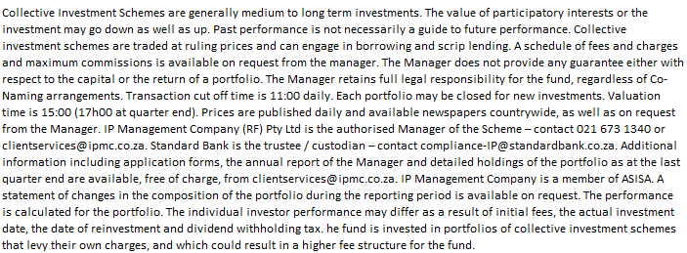
DISCLAIMER
Southchester Investment Managers (Pty) Ltd, an authorized financial services provider: FSP No. 44868

Slide 24
THANK YOU

